Slide 1
Sprint 6
gwloggeR v0.1.5

Slide 2
Agenda
gwloggeR website
User guide
Algorithm documentation
v0.1.5
Development guide
Next steps
Notes:
Vraag sprint 4: kunnen we in de resterende tijd iets maken dat tsoutliers-beperkingen omzeilt: vervolg is samenvatting van mijn poging.

Slide 3
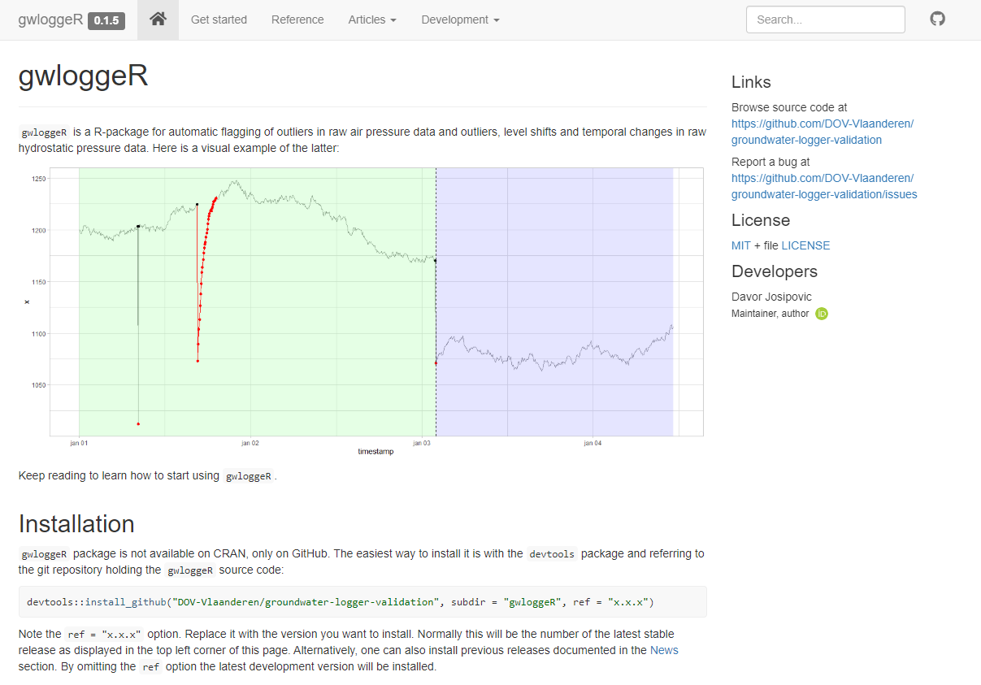
gwloggeR: website

Slide 4
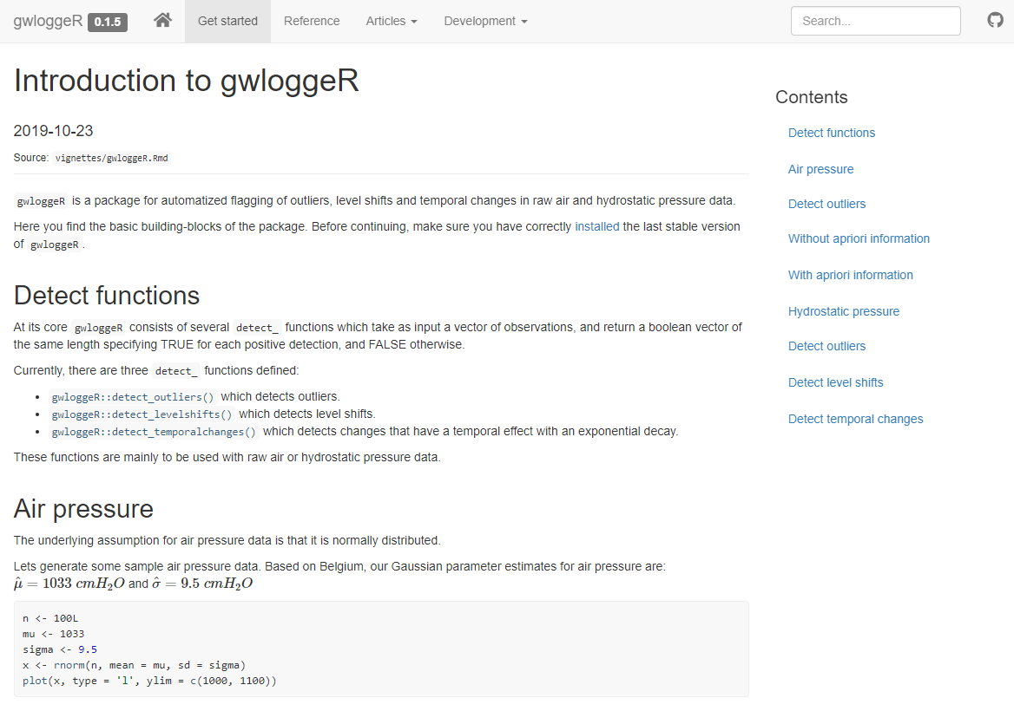
gwloggeR: getting started manual

Slide 5
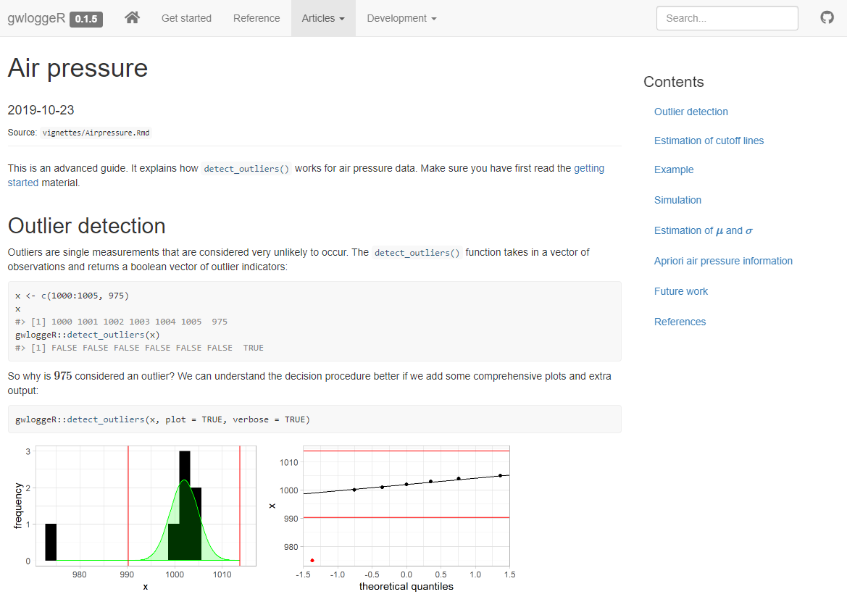
gwloggeR: air pressure vignette

Slide 6
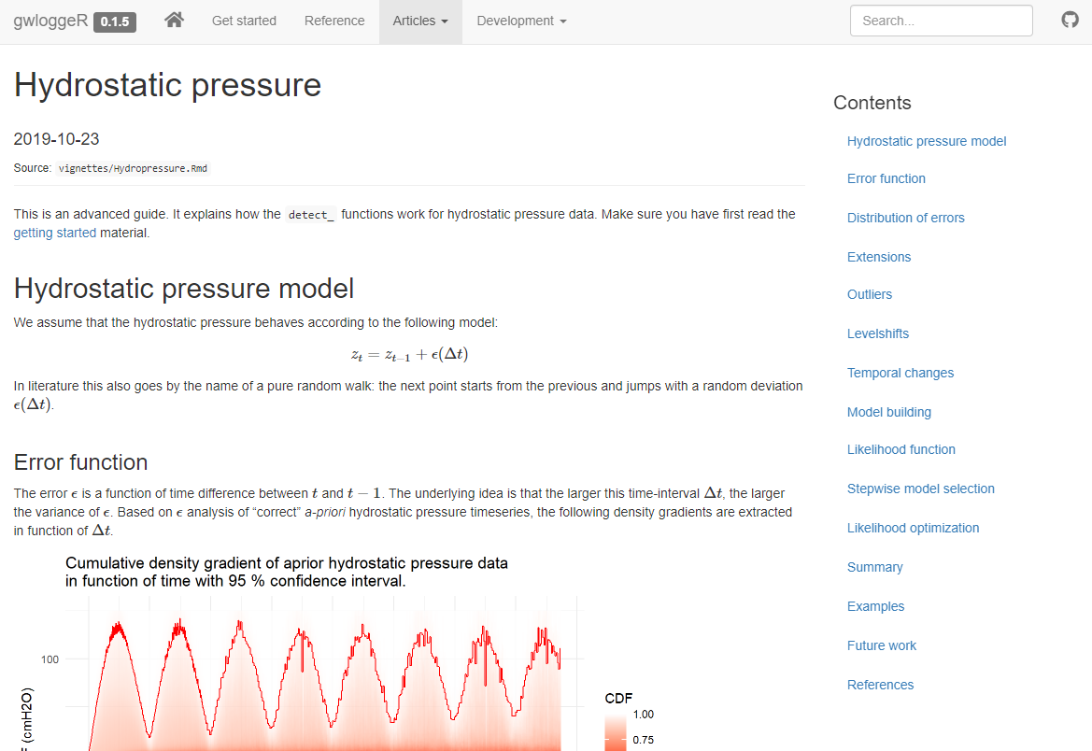
gwloggeR: hydrostatic pressure vignette

Slide 7
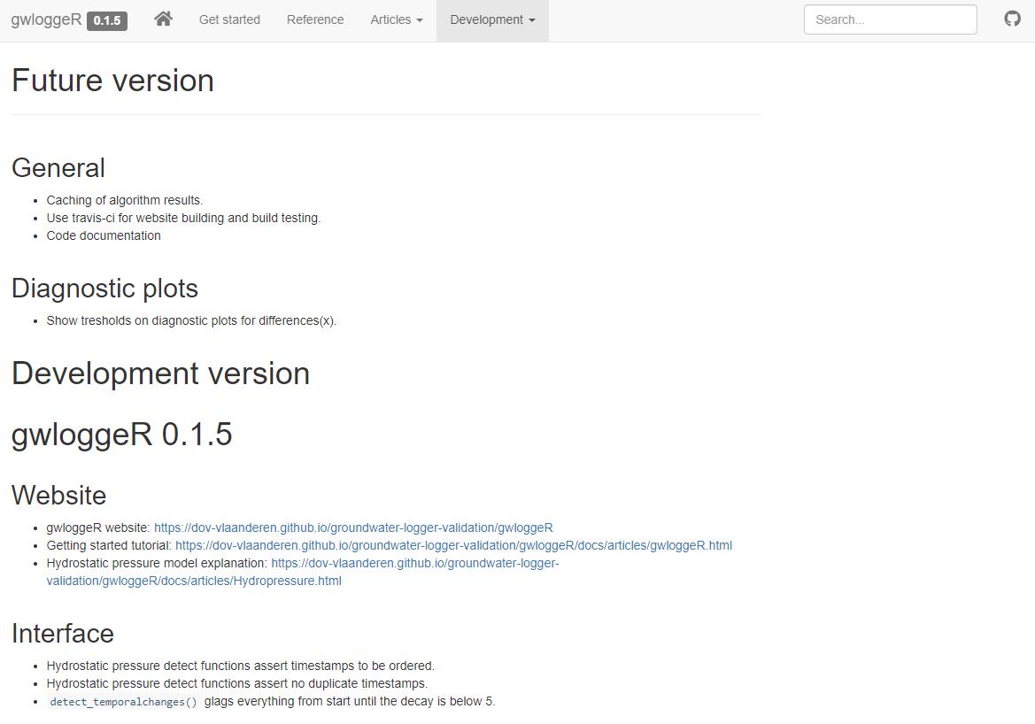
gwloggeR: v0.1.5

Slide 8
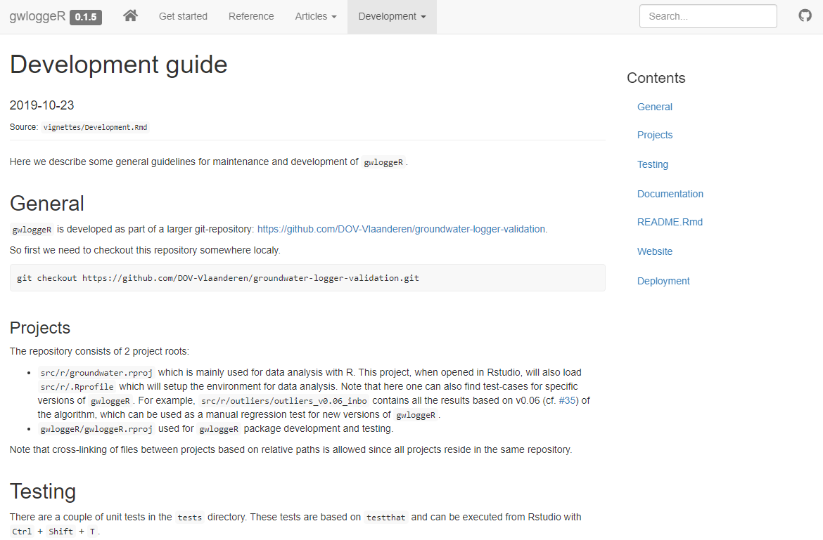
gwloggeR: development guide

Slide 9
Next Steps
See future work:
General
Air pressure
Hydrostatic pressure

Slide 10
The End

Slide 11
Sprint 5
Hydrostatic pressure AO, LS and TC detection

Slide 12
Agenda
Theoretical underpinnings:
Custom AO, LS and TC hydrostatic pressure detection
v0.05 (AO and LS detector)
v0.06 (AO, LS and TC detector)
Next steps
Notes:
Vraag sprint 4: kunnen we in de resterende tijd iets maken dat tsoutliers-beperkingen omzeilt: vervolg is samenvatting van mijn poging.

Slide 13
Theoretical underpinnings
Hydrostatic pressure AO, LS and TC detection

Slide 14
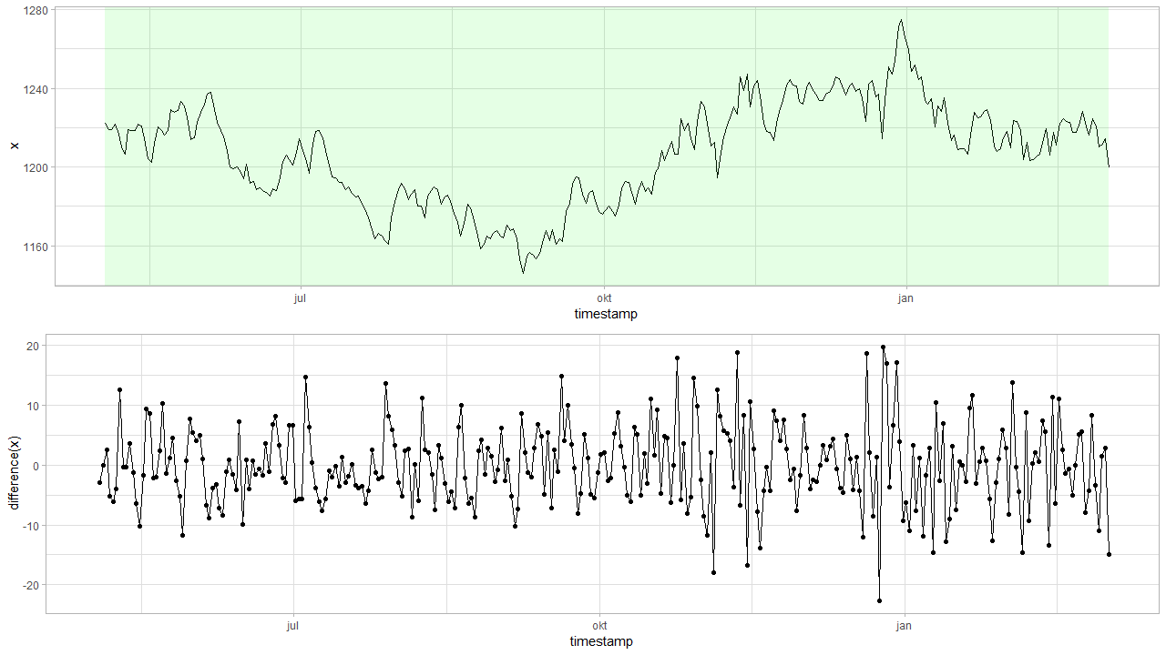

Model: $z_{t}=z_{t−1}+ε$
DYLP126X_F6843.csv
Notes:
Assumptie: simple first order diff model

Slide 15

Differences: $z_{t}−z_{t−1}=ε$
Notes:
How is epsilon distributed?

Slide 16
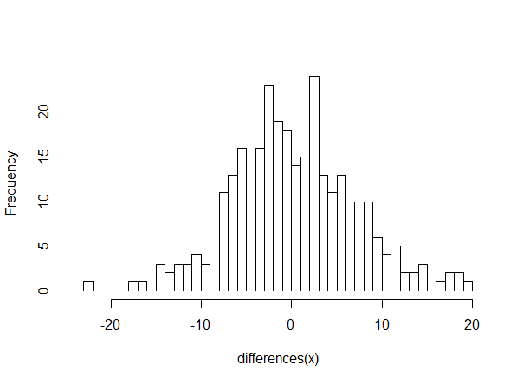

Differences: $z_{t}−z_{t−1}=ε$
$$Δt=1 day$$
Notes:
Normal? Something else?

Slide 17
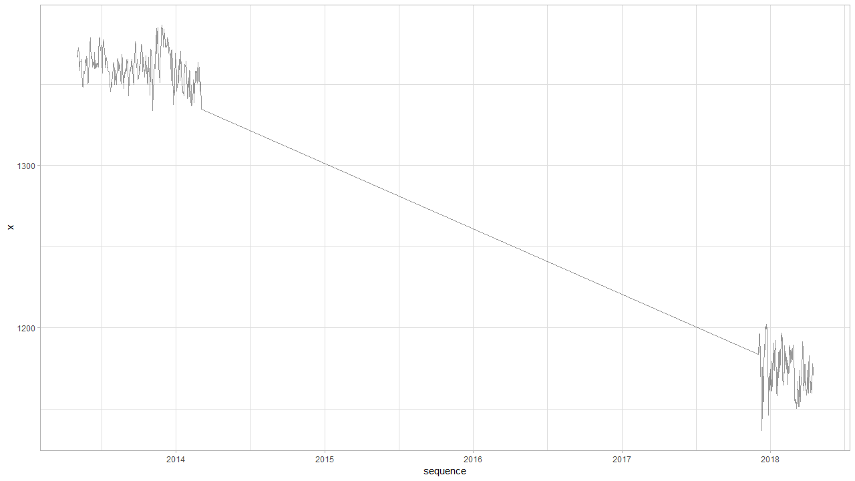

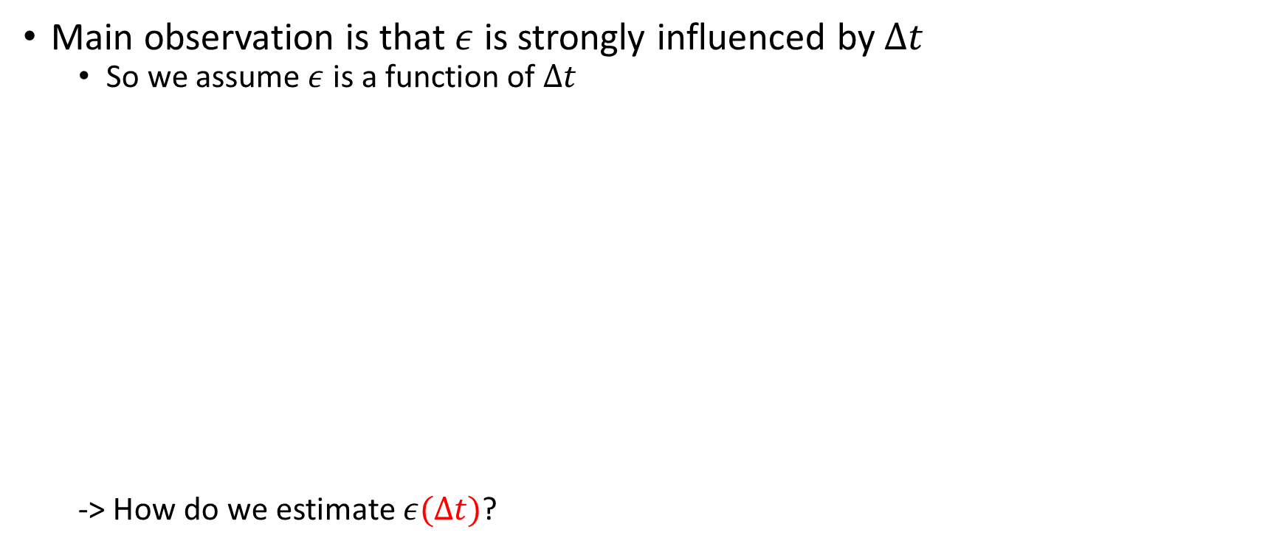
Observation: $z_{t}−z_{t−1}=ε(Δt)$
Main observation is that $ε$ is strongly influenced by $Δt$
So we assume $ε$ is a function of $Δt$
-> How do we estimate $ε(Δt)$?
Notes:
Big observation is that epsilon is a function of time: hoe plausible is het dat er na zo veel tijd zo’n grote jump is?

Slide 18
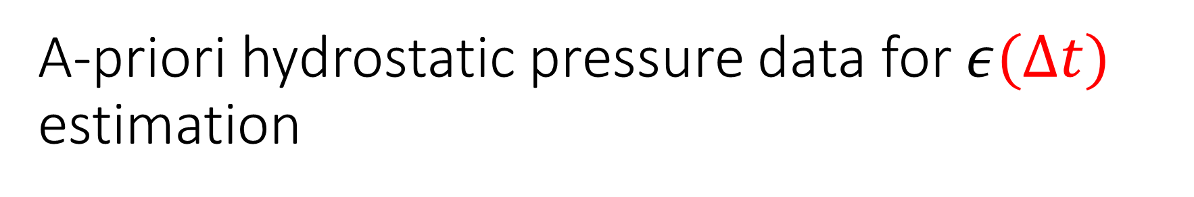
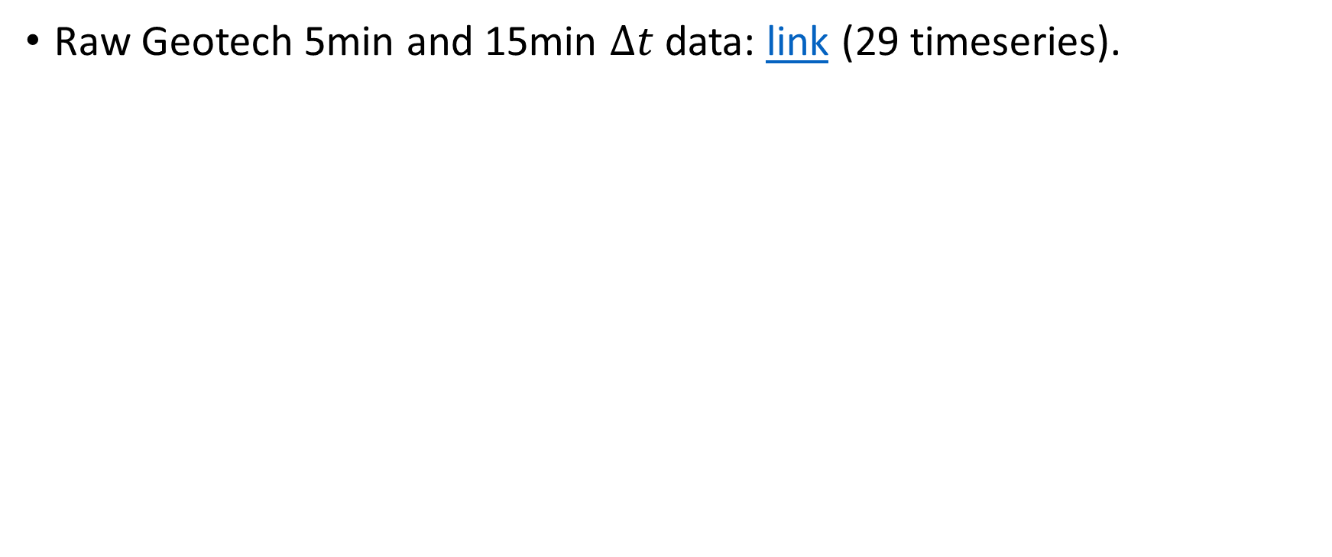
A-priori hydrostatic pressure data for $ε(Δt)$ estimation
Raw Geotech 5min and 15min $Δt$ data: link (29 timeseries).

Slide 19
Why not subsample intervals?
Problem
In case of very large intervals (e.g. month or more): only a few samples
Subsampling
Intuitively: not how a real logger works.
Independence assumption: does not work in case of subsampling.

Slide 20
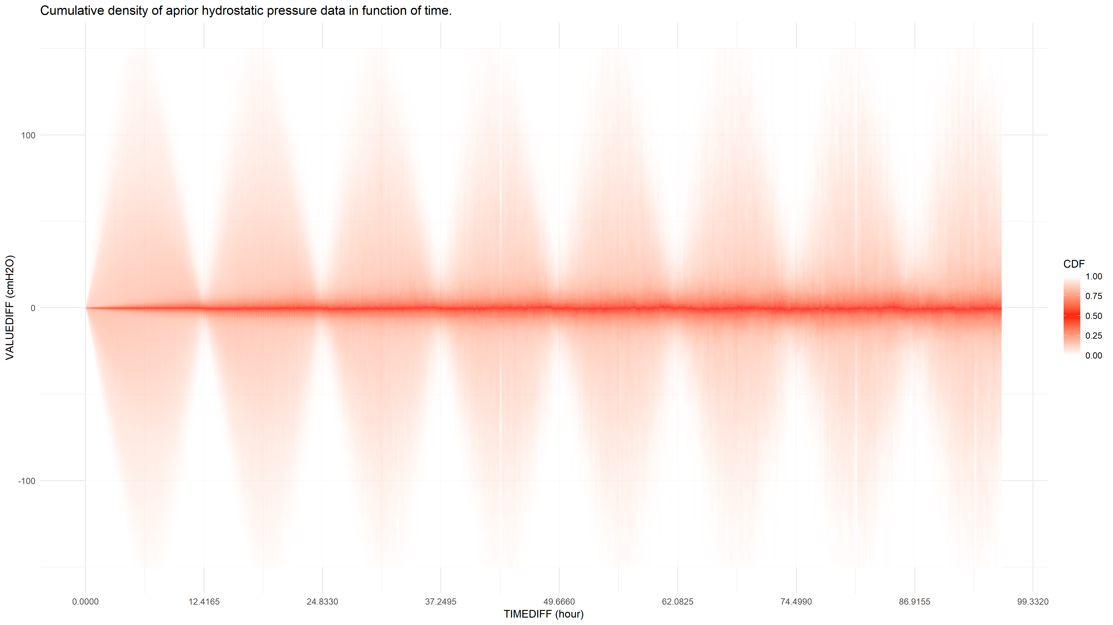

Density of $ε(Δt)$

Slide 21
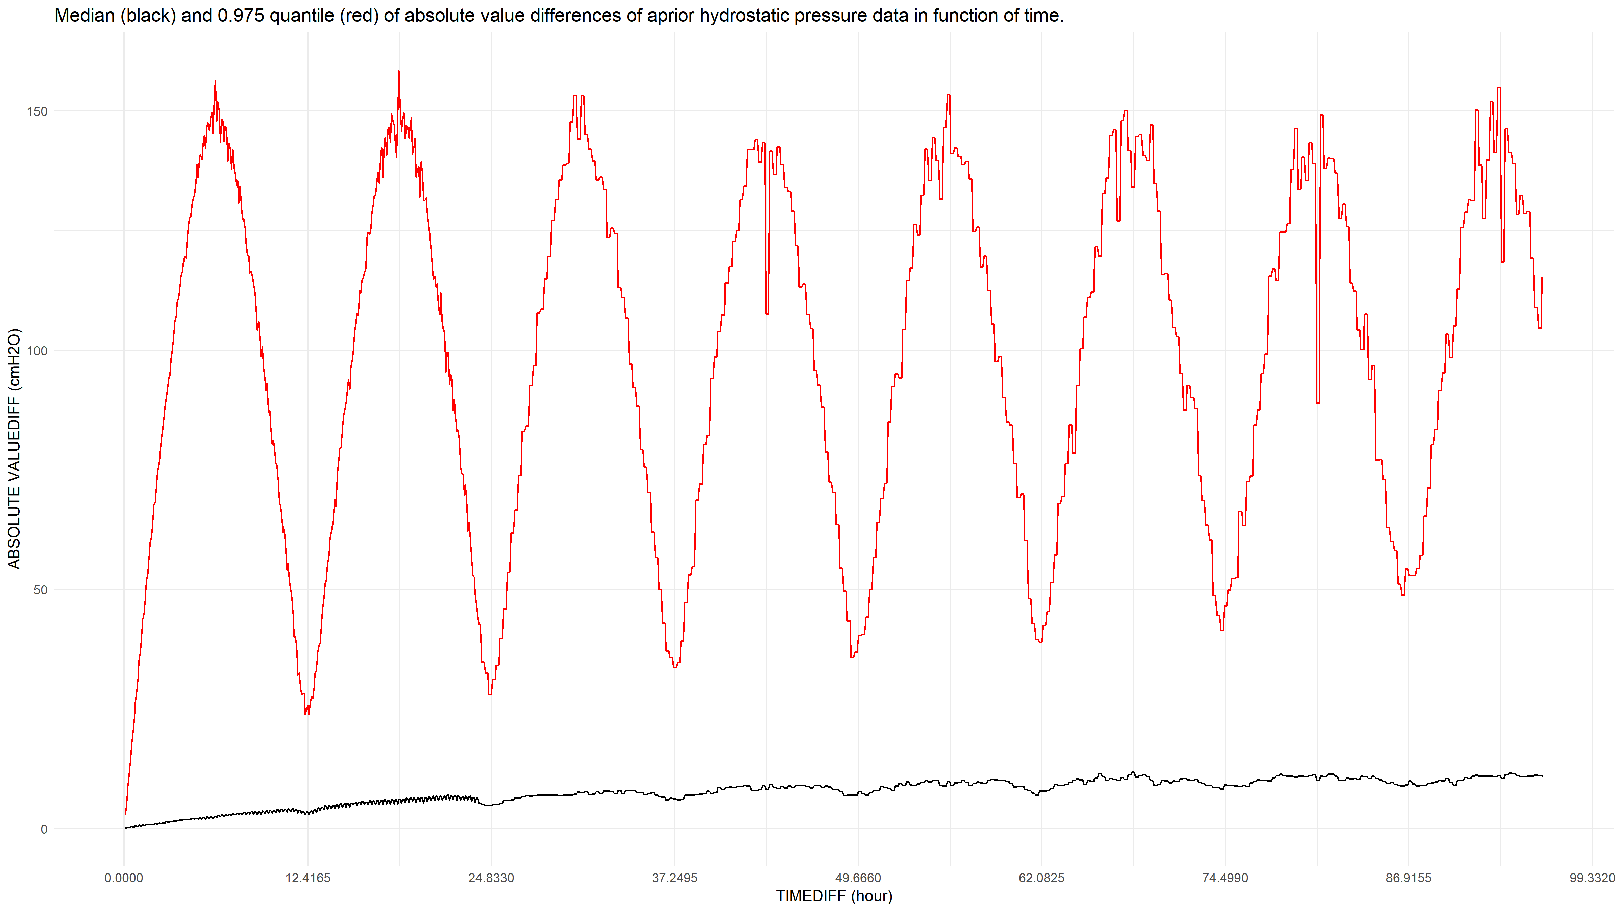

Median and 0.975 quantile of abs($ε(Δt)$)

Slide 22
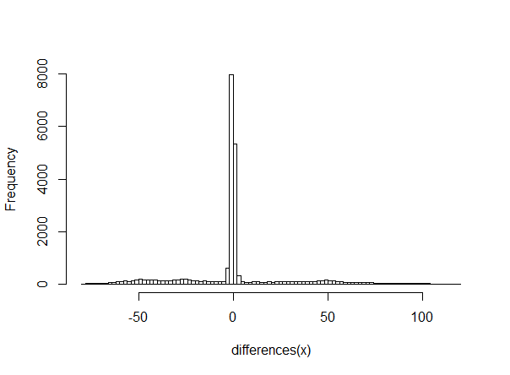
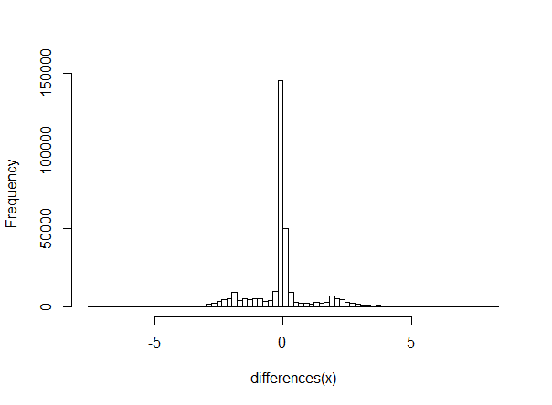
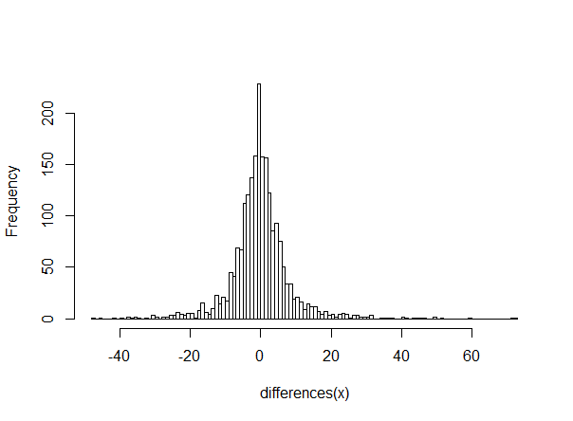



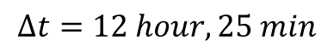
Distribution of $ε(Δt)$
$$Δt=1 hour$$
$$Δt=5 min$$
$$Δt=12 hour, 25 min$$
Removing tidal effect results in quasi-normality?
Notes:
Eens tidal effect is uitgefilterd lijkt het vrij normaal!
Now that we have the distribution we can start detecting:

Slide 23
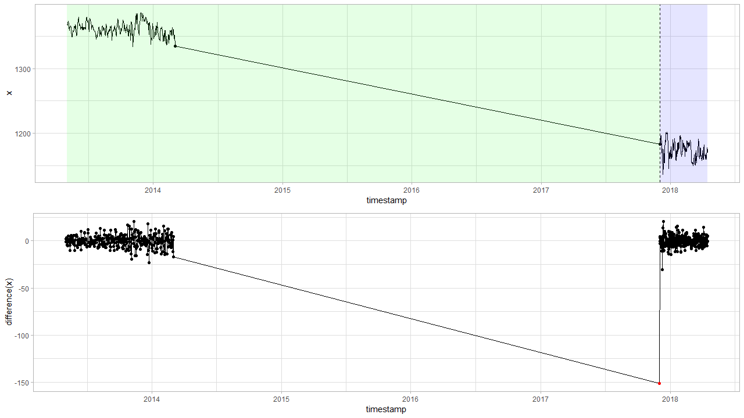

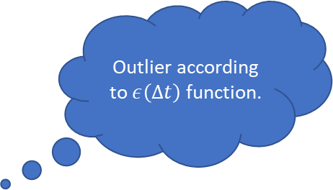
Detection based on a-priori information: $$z_{t}−z_{t−1}=ε(Δt)$$
Outlier according to $ε\left(Δt\right)$ function.

Slide 24
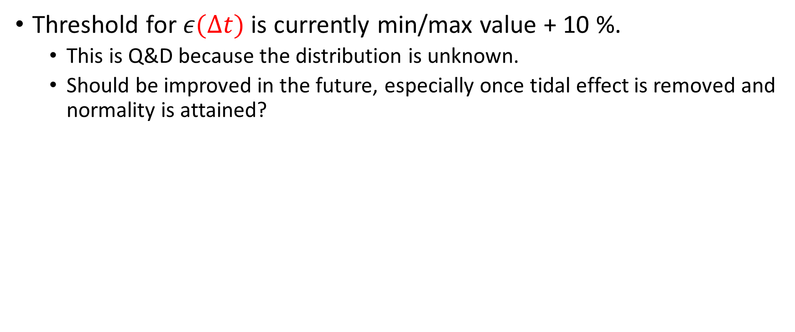

ToDo
Threshold for $ε(Δt)$ is currently min/max value + 10 %.
This is Q&D because the distribution is unknown.
Should be improved in the future, especially once tidal effect is removed and normality is attained?
$$Δt=5 min$$

Slide 25

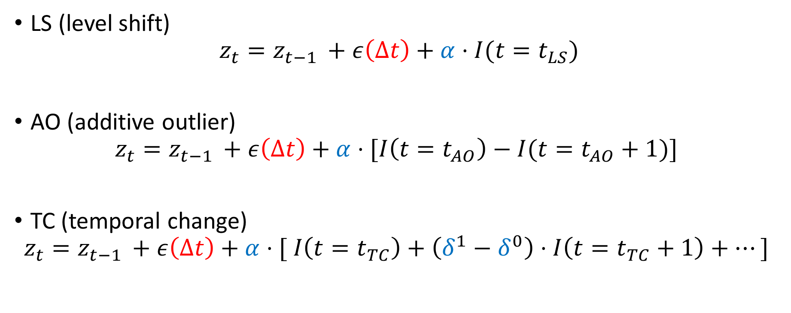
Outliers on a-priori $ε(Δt)$ can have different interpretations
Still looking for more simple formalization methods.
LS (level shift)
$$z_{t}=z_{t−1 }+ε\left(Δt\right)+α⋅I(t=t_{LS})$$
AO (additive outlier)
$$z_{t}=z_{t−1 }+ε\left(Δt\right)+α⋅[I\left(t=t_{AO}\right)−I(t=t_{AO}+1)]$$
TC (temporal change)
$$z_{t}=z_{t−1 }+ε\left(Δt\right)+α⋅[ I\left(t=t_{TC}\right)+\left(δ^{1}−δ^{0}\right)⋅I\left(t=t_{TC}+1\right)+…]$$
Notes:
Ben nog aan het zien naar betere/simpelere formalisatiemethode…

Slide 26
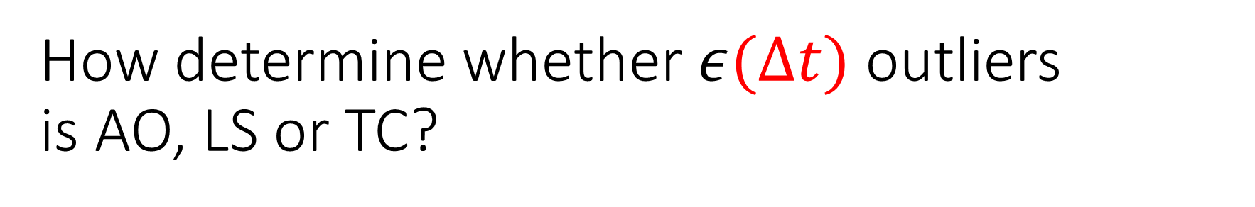
How determine whether $ε(Δt)$ outliers is AO, LS or TC?
Engineering approach
Simple at first sight, but becomes quite complex once special cases or TC is added
Not a real option
Statistical approach
Likelihood function needed
3 contenting models for each point AO, LS and TC

Slide 27
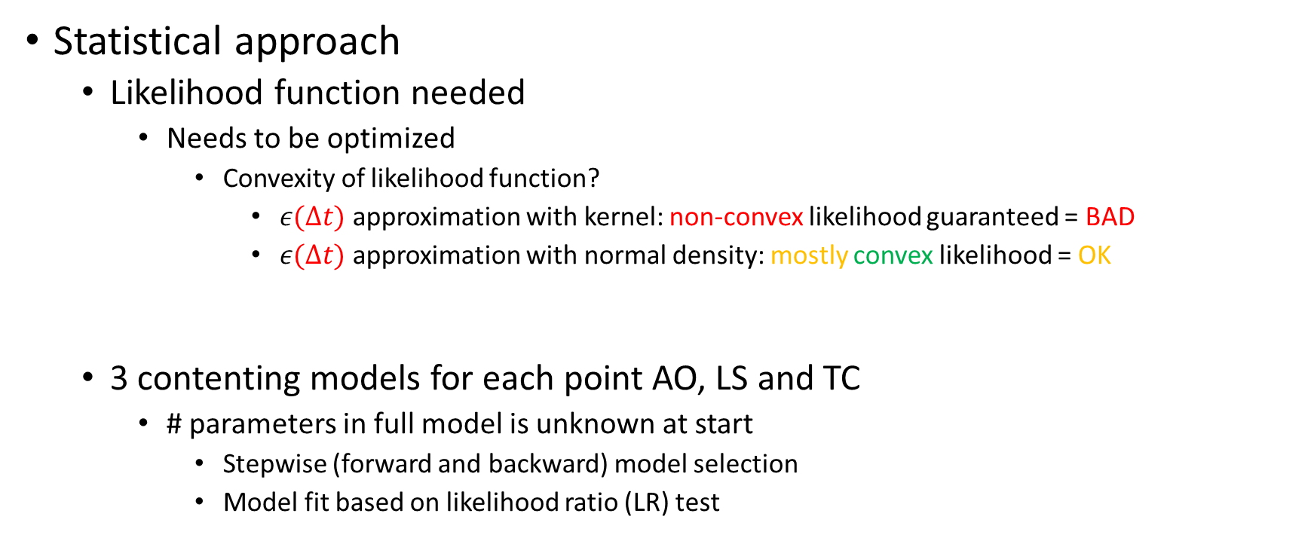
How determine whether $ε(Δt)$ outliers is AO, LS or TC?
Statistical approach
Likelihood function needed
Needs to be optimized
Convexity of likelihood function?
$ε(Δt)$ approximation with kernel: non-convex likelihood guaranteed = BAD
$ε(Δt)$ approximation with normal density: mostly convex likelihood = OK
3 contenting models for each point AO, LS and TC
# parameters in full model is unknown at start
Stepwise (forward and backward) model selection
Model fit based on likelihood ratio (LR) test
Notes:
We schatten dus epsilon(delta-t) op basis van normaliteit omdat de kans kleiner is dat we dan in een locale minima belanden.

Slide 28
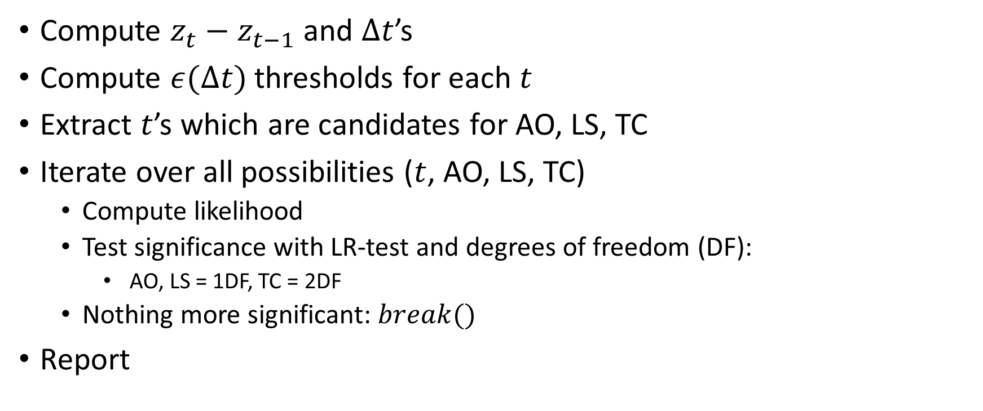
AO, LS, TC detection algorithm summary
Compute $z_{t}−z_{t−1}$ and $Δt$’s
Compute $ε(Δt)$ thresholds for each $t$
Extract $t$’s which are candidates for AO, LS, TC
Iterate over all possibilities ($t$, AO, LS, TC)
Compute likelihood
Test significance with LR-test and degrees of freedom (DF):
AO, LS = 1DF, TC = 2DF
Nothing more significant: $break()$
Report
type index alpha delta
1: AO 10824 -108.0 NA
2: AO 17175 -91.5 NA
3: LS 22552 -80.0 NA

Slide 29
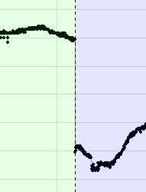
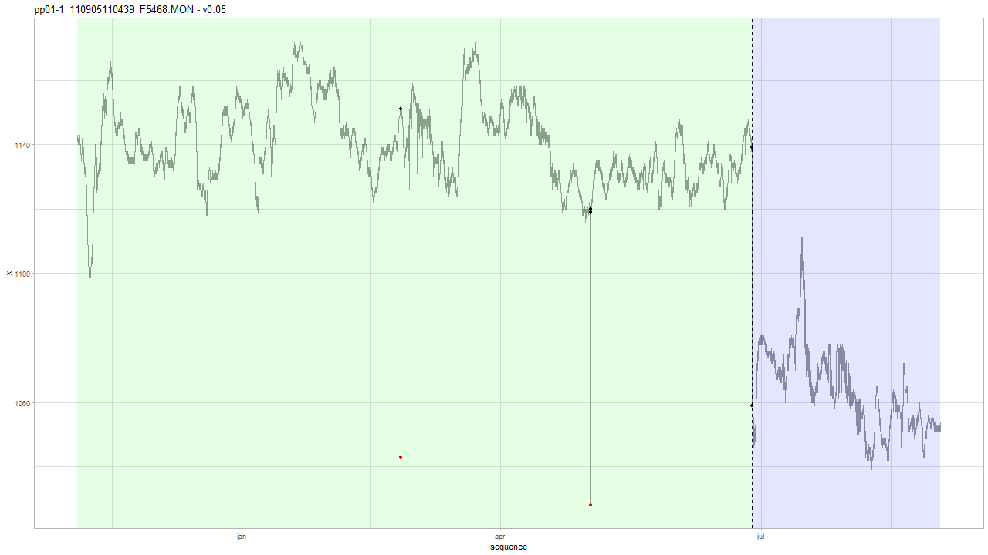
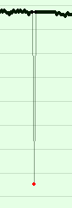
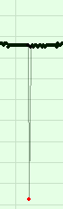
Example: Geotech v0.05
type index alpha delta
1: AO 10824 -108.0 NA
2: AO 17175 -91.5 NA
3: LS 22552 -80.0 NA
Notes:
type index alpha delta
1: AO 10824 -108.0 NA
2: AO 17175 -91.5 NA
3: LS 22552 -80.0 NA

Slide 30
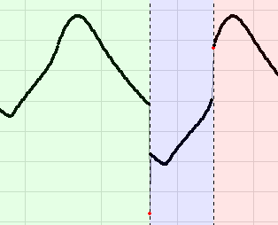
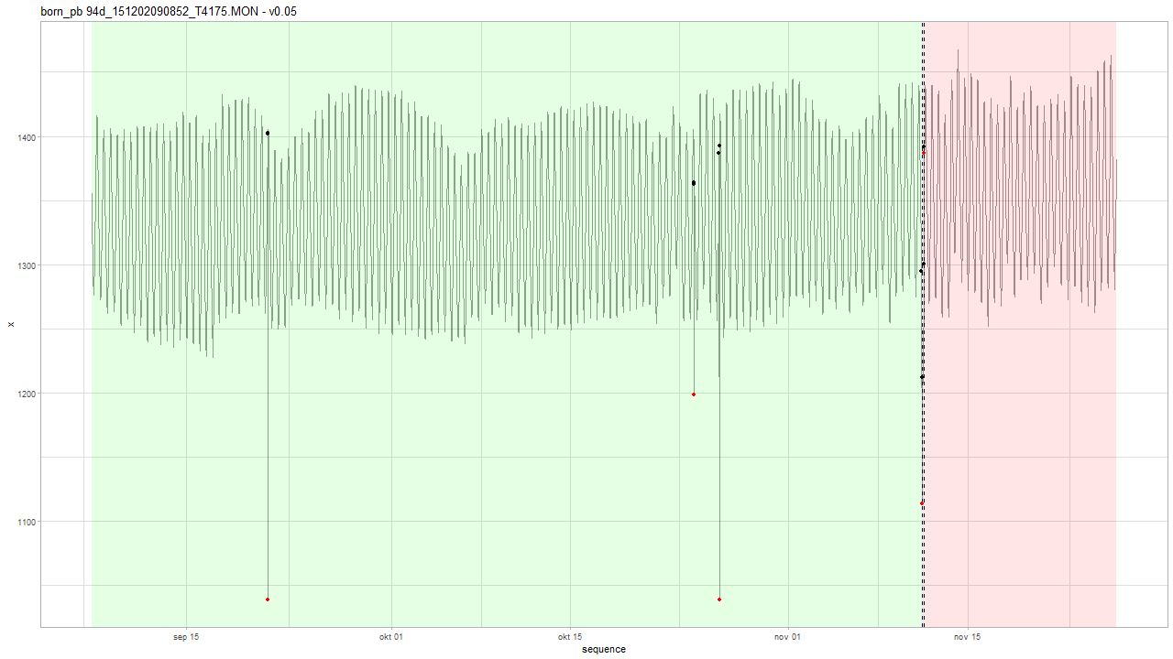
Example: Geotech v0.05
AO and LS at the same time.
Notes:
type index alpha delta
1: AO 3968 -363.446 NA
2: AO 13555 -164.792 NA
3: AO 14117 -351.283 NA
4: AO 18671 -98.525 NA
5: LS 18671 -83.125 NA
6: LS 18731 91.175 NA
7: AO 18731 -4.842 NA

Slide 31
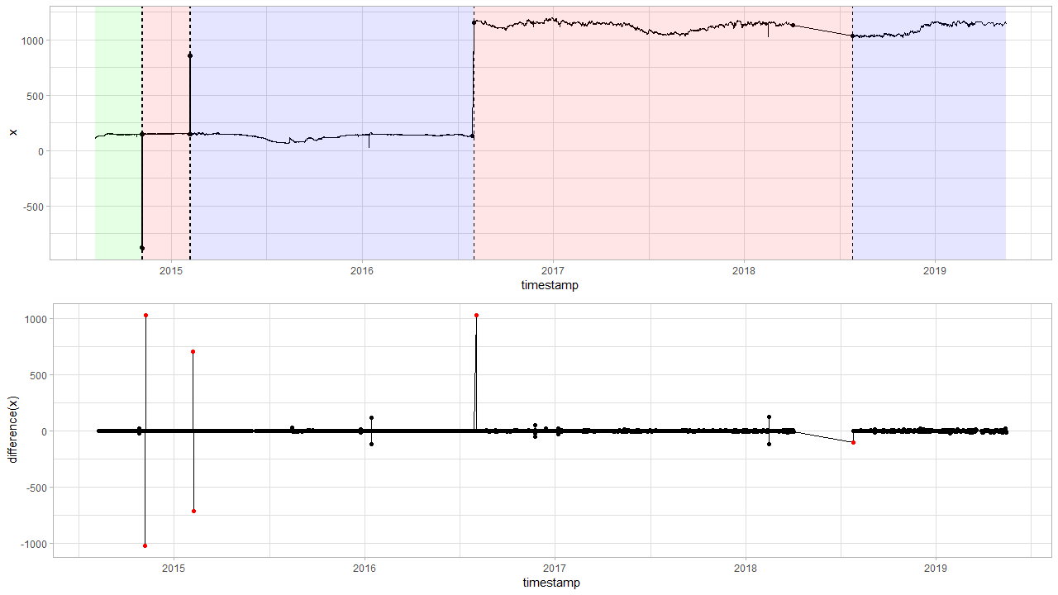
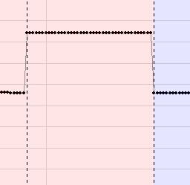
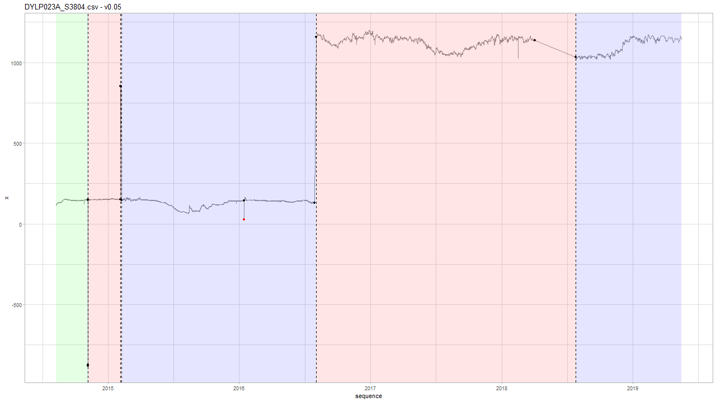
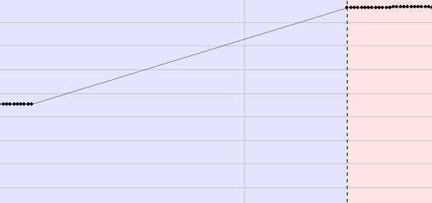
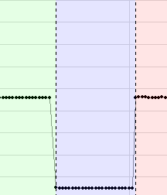
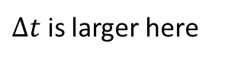
Example: INBO v0.05
Levelshift detection
$Δt$ is larger here
Notes:
Levelshifts voorbeelden.

Slide 32
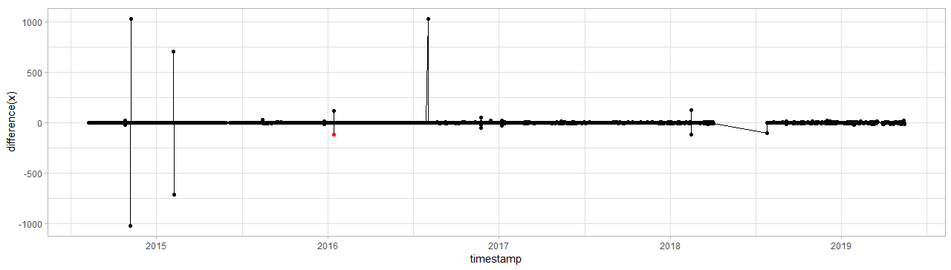
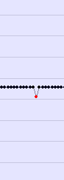
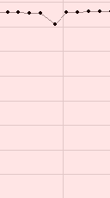
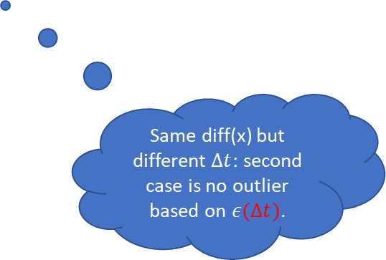
Example: INBO v0.05
Outlier detection
Same diff(x) but different $Δt$: second case is no outlier based on $ε(Δt)$.
Notes:
Levelshifts voorbeelden.

Slide 33
DYLP023A_S3804
tsdiff vdiff lower.bound upper.bound mu sigma2 n.dens c outlier
3600 -119.1260886 -41.5 75.9 0.000790494 176.504 42216 5.533473 TRUE
3600 118.8260229 -41.5 75.9 0.000790494 176.504 42216 5.533473 TRUE
14400 -116.9593409 -135.8 172.5 -0.011306911 1776.242 10539 4.916277 FALSE
10800 122.2678611 -114.8 149.9 0.001284348 1201.918 14062 5.319899 FALSE
Notes:
Hier is te zien dat er bij de eerste timediff 1u is, terwijl bij 2e om een langere periode gaat.

Slide 34
v0.05
AO and LS detection
(Comparison with Sprint 3 LS discussion)

Slide 35
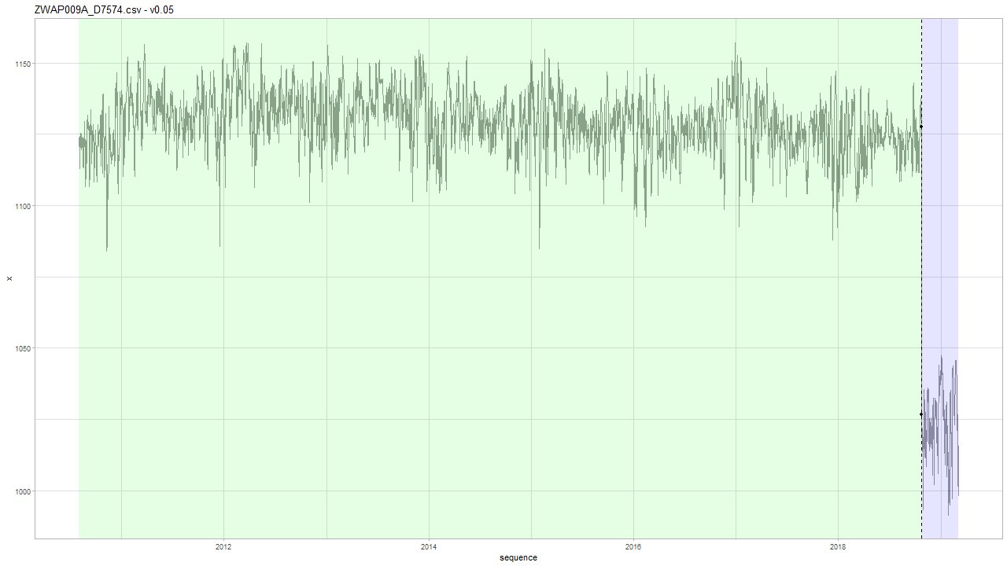
INBO: v0.05
Note: v0.05 has never seen INBO data, only 29 timeseries of Geotech data.

Slide 36
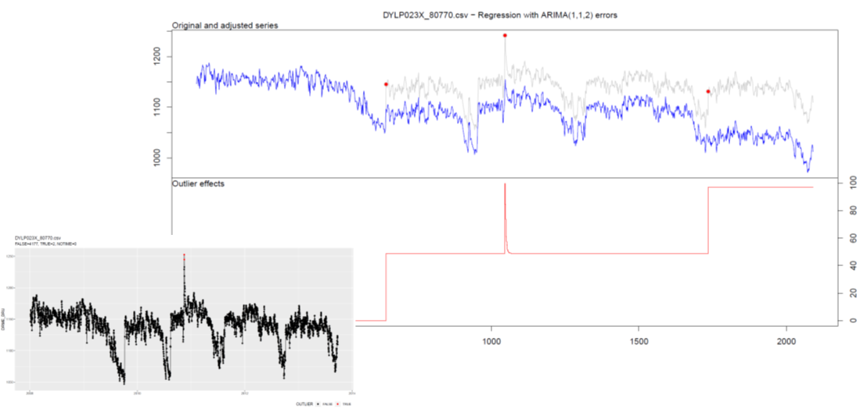
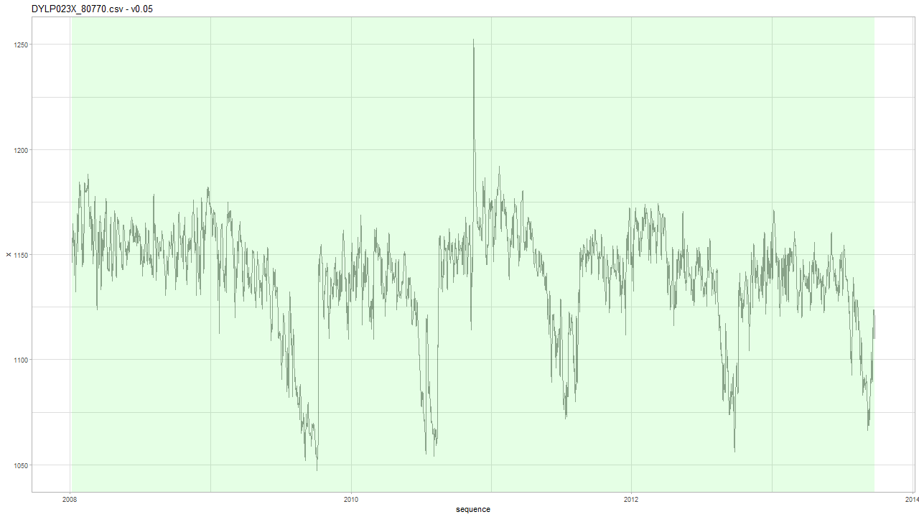
INBO: v0.05
Mathias: location is known. Dijle-valley. Highest peak is a flood. The other two are due to heavy rainfall before summer.

Slide 37
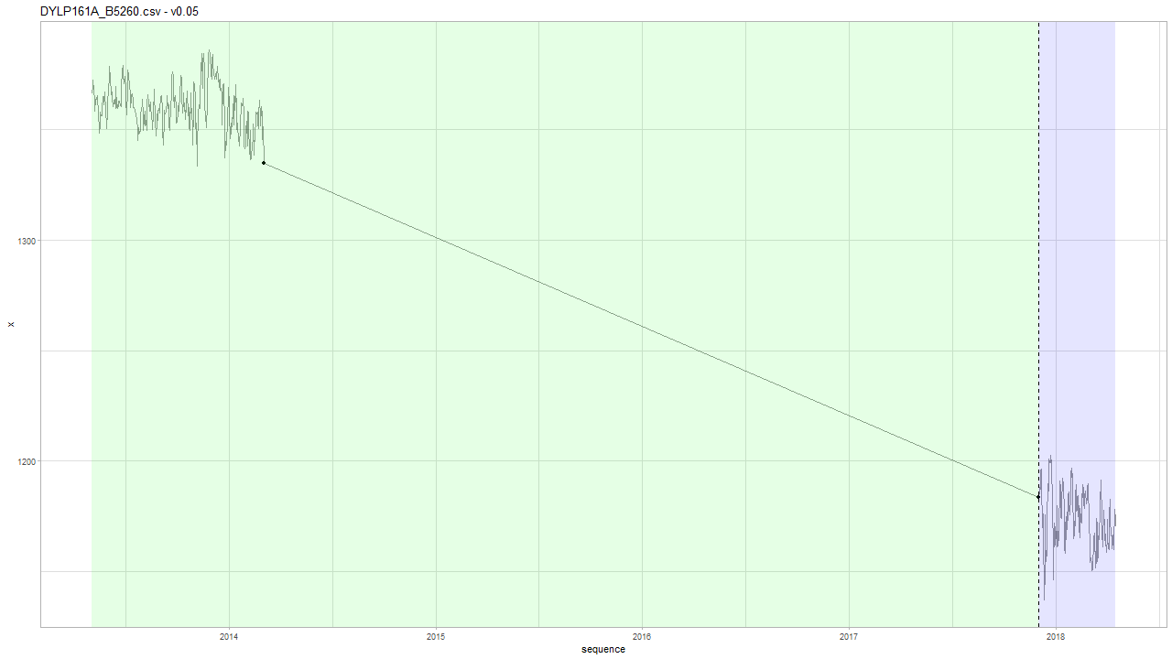

INBO: v0.05
Based on Geotech data we have $Δt$ < 1 month…
Notes:
Intuitief idee: na 4 jaar, wat is de kans dat die zo laag is gevallen?

Slide 38
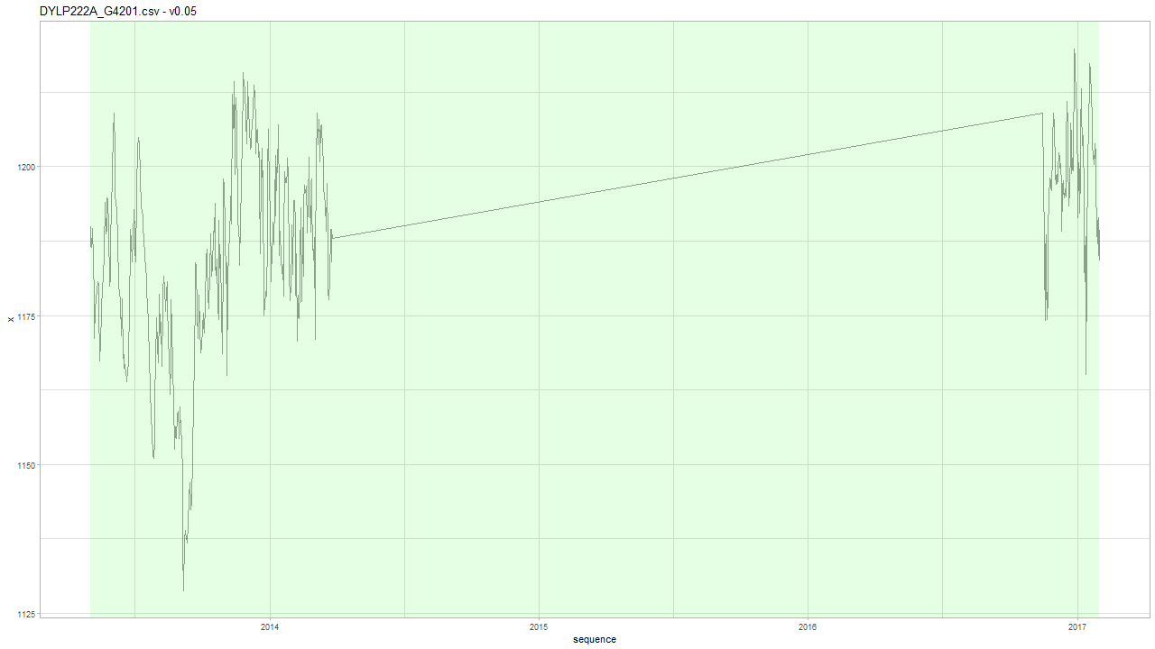
INBO: v0.05

Slide 39
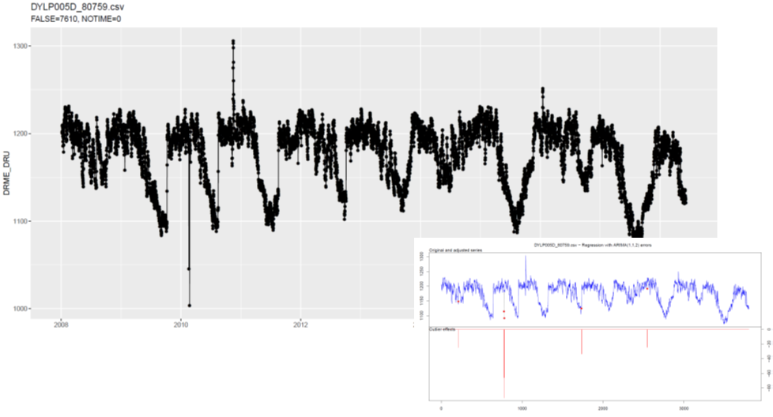
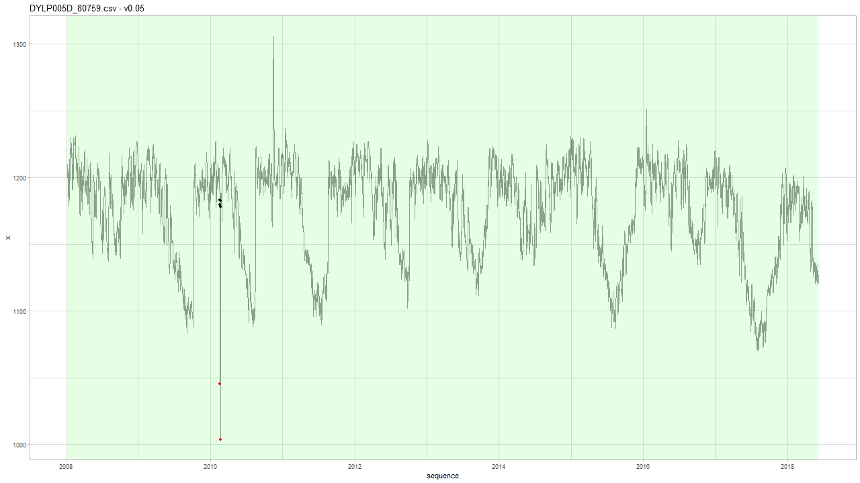
INBO: v0.05
Seasonality: yes LS: no

Slide 40
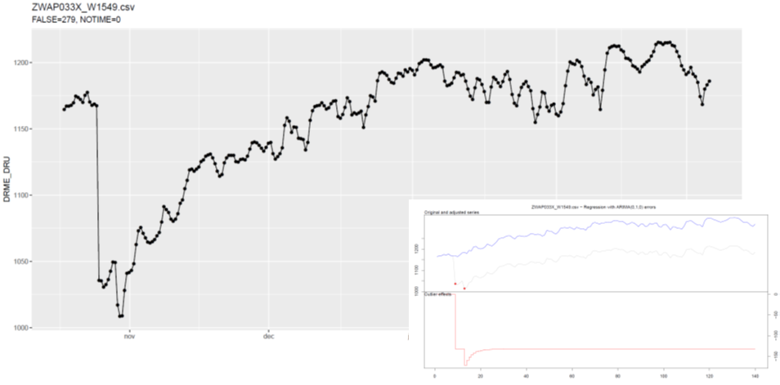
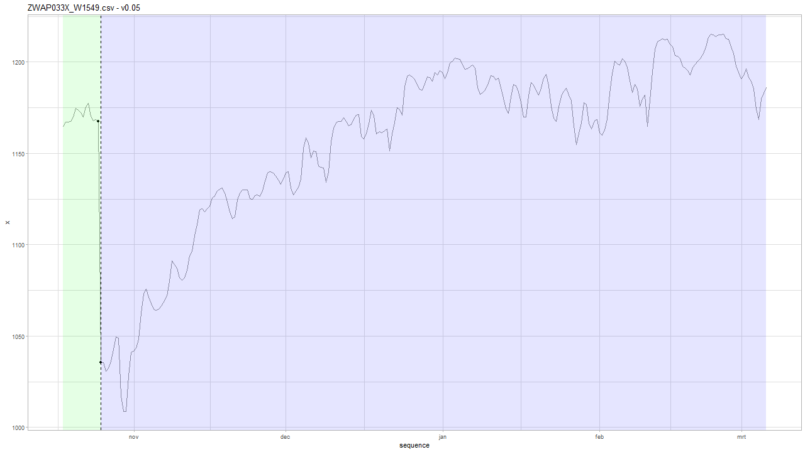
INBO: v0.05
Water withdrawal
Notes:
Water withdrawal. This should be flagged as level shift due to water withdrawal. Mathias: broken data logger... Frederic: best make difference between shifts that remain, and shifts that return? This is no ordinary LS.

Slide 41


INBO: v0.05
LS? Not according to a-priori Geotech data

Slide 42


INBO: v0.05
Seasonality or tidal effects due to 12h sampling?

Slide 43

Geotech v0.05
Notes:
type index alpha delta
1: LS 673 -385.6 NA
2: LS 683 342.0 NA

Slide 44





Geotech v0.05
Notes:
type index alpha delta
1: LS 8620 -74.317 NA
2: LS 8660 75.950 NA
3: AO 18420 -315.699 NA
4: LS 20693 -105.584 NA
5: AO 20693 5.075 NA
6: LS 23006 -66.091 NA
7: LS 23023 11.025 NA
8: LS 23333 122.617 NA
9: LS 31622 -369.950 NA

Slide 45
v0.06
AO, LS and TC detection

Slide 46


INBO: v0.06
Notes:
type index alpha delta
1: AO 332 -180.9308 NA
2: TC 1576 -165.0541 0.299719

Slide 47





INBO: v0.06
Notes:
type index alpha delta
1: LS 2 178.426 NA
2: TC 6 -116.917 0.548
3: TC 4218 -110.551 0.717
4: TC 4955 -179.956 0.713

Slide 48



INBO: v0.06
Threshold is set on 1/10000 = 0.0001 wrong tests….
LR test = 0.0019 for LS vs TC model.
☹
Notes:
type index alpha delta
1: LS 1906 -154.7760 NA
2: TC 2643 -205.3884 0.9
3: TC 2741 -188.7047 0.9
Browse[2]> base
[1] -6.138137
attr(,"par")
[1] -154.776
attr(,"types")
[1] "LS"
attr(,"indexes")
[1] 1
Browse[2]> pt$get(base.df + 1L)
[1] -1.326422
attr(,"par")
[1] -153.64 0.90
attr(,"types")
[1] "TC"
attr(,"indexes")
[1] 1
Browse[2]> lrtest(logL0 = base, logL = pt$get(base.df + 1L), df.diff = 1L)
[1] 0.001921106

Slide 49





INBO: v0.06
Threshold is set on 1/10000 = 0.0001 wrong tests….
LR test = 0.005 for LS vs TC model. ☹
Notes:
type index alpha delta
1: AO 1578 -54.779 NA
2: TC 1565 -99.690 0.661
3: TC 1547 -99.789 0.455
4: LS 6528 -83.536 NA

Slide 50




INBO: v0.06
Notes:
type index alpha delta
1: AO 1698 87.447 NA
2: AO 1674 -77.001 NA
3: LS 1665 73.573 NA
4: LS 1740 81.043 NA
5: AO 2097 79.124 NA
6: AO 2111 -71.188 NA
7: LS 2370 -218.148 NA
8: LS 2362 160.152 NA
9: LS 2380 152.116 NA
10: LS 2379 130.201 NA
11: LS 2382 109.761 NA
12: LS 2363 73.706 NA
13: AO 2370 49.139 NA
14: TC 2365 172.122 0.777
15: AO 2364 95.896 NA
16: LS 2676 82.418 NA
17: AO 2881 100.256 NA
18: LS 3071 587.422 NA
19: TC 3071 -421.719 0.756
20: LS 3070 70.966 NA
21: LS 3078 57.747 NA
22: AO 3119 -79.554 NA
23: LS 3107 -94.036 NA
24: LS 3110 -832.698 NA
25: LS 3108 -79.038 NA
26: LS 3114 234.116 NA
27: LS 3113 130.424 NA
28: TC 3110 745.722 0.900
29: LS 3120 138.363 NA
30: AO 3114 -101.795 NA
31: LS 3151 -120.416 NA
32: LS 3154 424.497 NA
33: LS 3149 137.709 NA
34: AO 3149 -67.512 NA
35: AO 3162 69.425 NA
36: TC 3154 -352.959 0.900
37: AO 4125 363.072 NA
38: LS 4125 128.011 NA
39: AO 4126 44.877 NA

Slide 51




Geotech: v0.06

Slide 52
Geotech: v0.05 vs. v0.06
Only differences in
born_pb 94d_151202090852_T4175.MON
born_pb 94d_160317114145_T4175.MON
born_pb 112d_151202090850_T4180.MON
pp09-1_120829130801_F5474.MON

Slide 53


Geotech: v0.06 vs. v0.05 born_pb 94d_151202090852_T4175.MON
V0.06
Notes:
type index alpha delta
1: AO 3968 -363.44550 NA
2: AO 13555 -164.79150 NA
3: AO 14117 -351.28300 NA
4: AO 18671 -98.52490 NA
5: LS 18671 -83.12519 NA
6: LS 18731 141.76297 NA
7: TC 18731 -55.43006 0.88835

Slide 54




Geotech: v0.06 vs. v0.05 born_pb 94d_160317114145_T4175.MON
V0.06 (Wrong)
V0.05 (Correct)
Notes:
type index alpha delta
1: TC 12646 -78.75362 0.9
2: LS 12819 18.66690 NA
3: LS 14964 -229.19110 NA
4: LS 14967 15.28390 NA
5: LS 17548 14.99090 NA
6: LS 18423 234.68931 NA
7: TC 18422 -26.10584 0.9
8: LS 21015 -379.05010 NA
9: LS 21051 334.48390 NA

Slide 55



Geotech: v0.06 vs. v0.05 born_pb 112d_151202090850_T4180.MON
V0.05
Takes 2 minutes to complete…
V0.06
Notes:
type index alpha delta
1: AO 3966 -336.291000 NA
2: LS 11151 -10.675097 NA
3: LS 11785 10.032903 NA
4: LS 19886 -182.234182 NA
5: AO 19908 -135.556366 NA
6: LS 19908 -28.647396 NA
7: LS 19930 35.651662 NA
8: LS 19929 24.020522 NA
9: LS 19931 18.204817 NA
10: LS 19922 98.079984 NA
11: TC 19922 -68.068404 0.861789
12: AO 19921 11.545716 NA
13: TC 19909 -49.970933 0.900000
14: LS 19928 7.035651 NA
15: LS 23049 -245.934097 NA

Slide 56


Geotech: v0.06 vs. v0.05 pp09-1_120829130801_F5474.MON
V0.06
Notes:
type index alpha delta
1: LS 12667 -115.47090 NA
2: TC 12667 67.47053 0.600487
3: AO 17938 -189.50000 NA
4: AO 26767 -340.00000 NA
5: AO 28706 -340.50000 NA

Slide 57
Summary
Compared to tsoutliers we have:
Speed: with TC detection ON, it usually takes less than a second or 2. There are few pathological cases: DYLP029A_S4054 and born_pb 112d_151202090850_T4180.MON that take 2 minutes to complete.
No need for aggregation
Variable decay
A-priori information
Variable time-intervals
Allows for step-by-step model improvement
Cons:
Ad hoc optimization (similar to tsoutliers)
Development/testing

Slide 58
Next Steps
Release version so it can be tested:
gwloggeR interface
Documentation (R-only)
Result caching:
AO, LS and TC need to be detected together: should not be recomputed for detect_levelshifts(), detect_outliers() and detect_temporalchange()
Refactor code
Better visualization of TC: draw exponential curve
Code refactoring…
Package:
version() function

Slide 59

Next Steps
Vignette for hydrostatic pressure
Summary of theoretical underpinnings of this presentation
v0.07: removing tidal effect
Should fix TC on tidal data.
Threshold for $ε(Δt)$ is now min/max value + 10 %
VMM data
make object for reading VMM data

Slide 60
The End

Slide 61
Agenda
Documentation
Diagnostic plots (outliers)
Air pressure: clean a-priori data
Universal data loading
Geotech data
Comparison outlier detection: v0.04 vs. tsoutliers
Next steps

Slide 62
Sprint 4
Documentation and diagnostic plots

Slide 63
Documentation
Vignette

Slide 64

Documentation
Vignette TOC
2 main parts:
Vignette
API interface
Goal: pkgdown-like documentation
Website-like documentation
Supported by github

Slide 65
Diagnostic plots
Outliers

Slide 66

Diagnostic plots detect_outliers(x, plot = TRUE)

Slide 67


Diagnostic plots detect_outliers(x, apriori(“air pressure”) , plot = TRUE)
A-priori (green)
$$μ=1033 cmH_{2}O$$
$$σ=9,58 cmH_{2}O$$
Notes:
Based on new data

Slide 68

Diagnostic plots detect_outliers(x, apriori(“hydrostatic pressure”) , plot = TRUE)
Notes:
Based on new data

Slide 69
Air pressure
Clean a-priori data

Slide 70

Air pressure: clean a-priori data
Notes:
Aggregated by day --> Some data is is high frequency (like BAOL033X) which has 20x or more datapoints than others, and thus has a higher weight on the distribution.
Are BAOL040X and BAOL010X and BAOL094X from the same region? And BAOL070X? This latter might be amplifying the left skewness.
Only data with a timestamp is taken into consideration.

Slide 71

Air pressure: aggregated clean a-priori data

Slide 72


Comparison: apriori air pressure red (sd/mean), green (robust), yellow (robust old data)
A-priori pressure data is as good as it can get…
Notes:
The green curve s the robust estimate for in v0.02 (mean = 1033.317 // sd = 9.586297). The yellow one is the old estimate (1034.2 // 9.93342).

Slide 73


Example (BAOL005X_72525) v0.03 (new) vs. v0.02 (old)
Notes:
Rechts: oude v0.02: eerste punt is geen outlier
Links: nieuwe v0.03: is outlier

Slide 74
Logger
Universal data loading

Slide 75

Uniform data loading: Logger object
Todo… VMM.
Static methods:
Logger::enumerate(partner = 'inbo')
Logger::enumerate(partner = 'geotech’)
Initialization:
df <- Logger('DYLP006X')$df
df <- Logger('ff_b29d_0903')$df
Uniform dataframe:
Primary key: MEASUREMENT_ID
UTC timestamp: TIMESTAMP_UTC
Value: PRESSURE_VALUE
Units: PRESSURE_UNIT
Notes:
Bedoeling is dat hier ook VMM data op een gelijkaardige manier wordt geladen.

Slide 76

VMM raw data?
http://www.ellitrack.nl/tracker/

Slide 77
Geotechniek
Outliers

Slide 78

Quick exploration
All data have timestamps without NA
Time intervals are either 5 or 15min:
5 min 15 min 1307676 436567
If necessary: best to aggregate on hourly basis?
The data is clearly seasonal and a random walk

Slide 79
Geotech outlier comparison
Main comparison file:
https://github.com/DOV-Vlaanderen/groundwater-logger-validation/blob/levelshifts/src/r/outliers/outliers_comparison_geotech.pdf
5 methods
v0.01: normality assumption
v0.02: upper level = apriori air pressure, lower level normality assumption
v0.04: based on apriori difference min(left-diff, right-diff) knowledge:
5min: max 10cmH2O
tsoutliers:
Full: AO, TC, LS
AO only highlights with difference plot

Slide 80
tsoutliers --> AO
v0.01
v0.02
v0.04
tsoutliers --> AO, TC, LS

Slide 81
Geotech outlier comparison: v0.01
Data not normal but a seasonal random walk.

Slide 82
Geotech outlier comparison: v0.01
Sometimes it works, but mostly not…

Slide 83

Geotech outlier comparison: v0.02
Similar to v0.01…

Slide 84
Geotech outlier comparison: v0.02
In the air…
“valid data”
Notes:
Voordeel is dus dat je gemakkelijk kan zien of de data wel “valid is” … maar daar stopt het wel.

Slide 85




Geotech outlier comparison: v0.04
Q&D threshold: $10 cmH2O$
Q&D threshold: $30 cmH2O$
Notes:
Treshold: 10 and 30 cmH2O

Slide 86
Geotech outlier comparison: v0.04
Detected… (cf. v0.01 not detected)

Slide 87
Geotech outlier comparison: v0.04
Detected… (cf. v0.01 not detected)

Slide 88
Geotech outlier comparison: v0.04
Detected… (cf. tsoutliers not detected due to aggregation)

Slide 89
Geotech outlier comparison: v0.04
Detected… (cf. tsoutliers not detected due to last point or agg.)

Slide 90

Geotech outlier comparison: v0.04
Missed due to multiple points. Level shift?

Slide 91

Geotech outlier comparison: v0.04
Also missed.
Level shift?

Slide 92
Geotech outlier comparison: tsoutliers
tsoutliers found it. Wrong point??

Slide 93
Geotech outlier comparison: tsoutliers
Weird… (v0.04 detects nothing)

Slide 94
tsoutliers detects two outliers? v0.04 nothing

Slide 95
Only v0.04 detected…

Slide 96
tsoutliers detects level shifts also…

Slide 97
tsoutliers aggregates: how to extract 1 single point.
Notes:
Omwille van aggregatie op uur ziet de tsoutlier plot er lichtjes anders uit.

Slide 98
Geotech outlier comparison: conclusion
v0.01 and v0.02
Normality assumption doesn’t apply to hydrostatic pressure.
v0.02 could be used to assess validity of data.
tsoutliers
Sometimes detects weird AO’s due to auto.arima model.
Slow: +10h on pp09-2_120829131517_F8511, pp08-2_120829135933_F8503, ff_b51d_090429160102_C4089
Aggregation required --> makes outlier detection and extraction of 1 point difficult.
Biggest strength is LS detection.
Personal note: we should be able to make something better.
v0.04
Is intelligible and fast.
Has no problems with first point and last point being outliers.
Is good in detecting 1 point outliers.
Has problems with > 1 point sequential outliers --> level shift?
Has best potential for outlier detection?

Slide 99
Level shifts: summary
Suggestion:
Reference algorithm (for comparison): tsoutliers
A custom approach…

Slide 100
Level shift?
Notes:
Omwille van aggregatie op uur ziet de tsoutlier plot er lichtjes anders uit.

Slide 101
No level shift?
Notes:
Omwille van aggregatie op uur ziet de tsoutlier plot er lichtjes anders uit.

Slide 102
Multiple level shifts?

Slide 103
Clear level shift.

Slide 104
Clear short level shift and outlier.

Slide 105
Next steps

Slide 106
Next steps
VMM data?
Focus on intelligible models vs. tsoutliers?
In case of outlier detection: you know “why”.
Improve and implement v0.04?
Level shifts
Improve tsoutliers (i.e. detect only large level shifts)
Make diagnostic plots for level shifts.
Custom approach…?

Slide 107
The End

Slide 108
Sprint 3
Level shifts

Slide 109
Agenda
Outliers
Level shifts
strucchange package
tsoutliers package
rank-based shift detection
Timestamps
Data aggregation
gwloggeR v0.1.2

Slide 110
Outliers
Recap

Slide 111


Outliers: v0.02
Validation
Excluded: BAOL089|BAOL079|BAOL006 (mBar)
Range: 800 < x < 1200
Notes:
Excluded: BAOL089|BAOL079|BAOL006
Range: 800 < x < 1200

Slide 112
Outliers: v0.02 example detect_outliers(x, apriori("air pressure", "cmH2O"))

Slide 113
Outliers: v0.02
Next steps
Build kernel based on clean data
Simulation test: verify power
Document in detail
Notes:
Excluded: BAOL089|BAOL079|BAOL006
Range: 800 < x < 1200

Slide 114
Level Shifts
strucchange
tsoutliers
rank-based

Slide 115
strucchange package
For modeling changes in mean

Slide 116
Level shift?

Slide 117
Strucchange package

Slide 118
Strucchange package
Pros:
Detects changes in a linear model (e.g. intercept only linear regression)
Mature package
Speed: 5 min average
Cons:
No ARIMA support
Uses lots of memory (+5GB on some cases)

Slide 119
tsoutliers package
For modeling level shifts with ARIMA models

Slide 120


tsoutliers package
Notes:
Wat hier ook kan zijn, is dat intussentijd de situatie gewoon geleidelijk is gewijzigd: dus niet abrupt.

Slide 121
tsoutliers package
Notes:
Wat hier ook kan zijn, is dat intussentijd de situatie gewoon geleidelijk is gewijzigd: dus niet abrupt.

Slide 122
tsoutliers package
Notes:
Wat hier ook kan zijn, is dat intussentijd de situatie gewoon geleidelijk is gewijzigd: dus niet abrupt.

Slide 123
tsoutliers package
More cases: see here.

Slide 124
tsoutliers package
Pros:
Allows for a wide range of ARIMA-based models
Seems to detect LS well
Speed: 10 min average with aggregation
Cons:
Can not be used without aggregation (for >5k points)
Package is still in development

Slide 125
Rank-based shift detection
For modeling level shifts with rank-based statistics

Slide 126
Rank based level shift detection
Fried, R. e.a., On rank tests for shift detection in time series, 2007
Bovik, A.C. e.a., Nonparametric Tests for Edge Detection in Noise, 1986
Based on the distribution of a test statistic (e.g. Wilcoxon statistic) the normal situation can be defined. Based on this definition, exceptional shift situations could be detected.
Pro: speed!

Slide 127
Defining Level Shift
Discussion

Slide 128
Level shift?

Slide 129
Level shift?
Notes:
Lots of missing data!!

Slide 130
Level shift?
Notes:
Lots of missing data!!

Slide 131
Level shift?

Slide 132
Level shift?

Slide 133
Level shift?
Notes:
2 shifts?

Slide 134
Level shift?
Notes:
Is rood een flat line?

Slide 135

Level shift?

Slide 136


Level shift?

Slide 137
Level shift?

Slide 138
Level shift: tsoutliers

Slide 139

Level shift?
Notes:
Is rood een flat line?

Slide 140

Level shift?
?
Notes:
Is rood een flat line?

Slide 141

Level shift?
Notes:
Is rood een flat line?

Slide 142
Timestamps

Slide 143

Timestamps: varying time-difference between observations (BAOL068X_180816.csv)
Sometimes 11, 12 or 13 hours
Notes:
BAOL068X_180816.csv

Slide 144
Timestamps: varying time-difference between observations
Equidistant observations are important for ARIMA-like timeseries models.
Without equidistance, the usability of ARIMA is limited.
Example: Differencing
For small time-differences: measured differences determined by sensor inaccuracy
For large time-differences: measured differences determined by sensor inaccuracy and atmospheric changes.
Timestamps: Take into account all kinds of scenarios?

Slide 145
Importance
Visualization:
Its either TIMESTAMP or SEQUENCE
INBO:
Can make sure that timestamp is always available.
Other parties?

Slide 146
gwloggeR
Change log
Feedback?

Slide 147
Change log
“Diver” → “hydrostatic pressure”
ap <- apriori("hydrostatic pressure", "cmH2O")
detect_outliers(x, apriori = ap)
detect_duplicates(ts)

Slide 148
Aggregation function
Lump together and take average.
Other (better?) ways?

Slide 149
Next steps

Slide 150
Next steps
Outliers v0.02
Build kernel based on clean data
Simulation test: verify power
Document in detail
Level shifts:
Gather more Level Shift examples
Better visualization
“Nederlanders”?

Slide 151
Hysteresis?

Slide 152
The End

Slide 153
Sprint 2
Outliers

Slide 154
Agenda
DRME_DMST_CDE validation
Outliers: v0.02 update
Comparison v0.01 vs v0.02
gwloggeR v0.1.1
Assessment
anomalize
tsoutliers

Slide 155
DRME_DMST_CDE
Flags from DB: ENT (entered); DEL (deleted) and INV (invalid).

Slide 156
DRME_DMST_CDE
On all *.csv-data:
DEL ENT INV VLD <NA>
462 556271 4697 16 0

Slide 157
DRME_DMST_CDE: VLD and DEL
PPNT_ID PPNT_CDE DRSO_ID DRSO_SER_NBR DRME_ID DRME_OCR_UTC_DTE DRME_DRU DRME_TPU DRME_DMTP_CDE DRME_DMST_CDE SEQUENCE
1: 7019 BAOL001X 275 D0939 238389 2010-11-11 10:00:00 1018.100 NA LDME VLD 1093
2: 7019 BAOL001X 275 D0939 1824560 2010-11-11 10:00:00 1018.075 6.033 LDME ENT 1130
3: 7019 BAOL001X 275 D0939 238390 2010-11-11 22:00:00 1007.300 NA LDME VLD 1094
4: 7019 BAOL001X 275 D0939 1824561 2010-11-11 22:00:00 1007.275 8.163 LDME ENT 1131
5: 7019 BAOL001X 275 D0939 238391 2010-11-12 10:00:00 1015.400 NA LDME VLD 1095
6: 7019 BAOL001X 275 D0939 1824562 2010-11-12 10:00:00 1015.375 11.213 LDME ENT 1132
7: 7019 BAOL001X 275 D0939 238392 2010-11-12 22:00:00 1012.900 NA LDME VLD 1096
8: 7019 BAOL001X 275 D0939 1824563 2010-11-12 22:00:00 1012.850 12.457 LDME ENT 1133
9: 7019 BAOL001X 275 D0939 238393 2010-11-13 10:00:00 1014.600 NA LDME VLD 1097
10: 7019 BAOL001X 275 D0939 1824564 2010-11-13 10:00:00 1014.600 10.810 LDME ENT 1134
11: 7019 BAOL001X 275 D0939 238394 2010-11-13 22:00:00 1012.700 NA LDME VLD 1098
12: 7019 BAOL001X 275 D0939 1824565 2010-11-13 22:00:00 1012.675 10.953 LDME ENT 1135
Duplicates: Detect those too?
Notes:
Duplicaten in de DB?

Slide 158
DRME_DMST_CDE: INV
Validation

Slide 159
DRME_DMST_CDE: INV
Validation

Slide 160

DRME_DMST_CDE: INV
Validation
No Timestamp (Inconsistent)
No Timestamp: Detect those too?
Notes:
Inconsistent because there are also black dots that have no timestamp.

Slide 161
Outliers: v0.02 update
Uses simple a-priori knowledge about air pressure, temperature, etc.

Slide 162
Outliers: v0.02 update
Validation
Excluded: BAOL089|BAOL079|BAOL006 (mBar)
Range: 800 < x < 1200
Notes:
Excluded: BAOL089|BAOL079|BAOL006
Range: 800 < x < 1200

Slide 163
Outlier comparison
v0.01, v0.02, DRME_DMST_CDE

Slide 164
Outlier comparison

Slide 165
Outlier comparison

Slide 166
Outlier comparison

Slide 167
Outlier comparison

Slide 168
Outlier comparison

Slide 169
Outlier comparison

Slide 170
Outlier comparison

Slide 171
Outlier comparison

Slide 172
tsoutliers package

Slide 173

tsoutliers package
auto.arima(Nile)
Series: Nile
ARIMA(1,1,1)
Coefficients:
ar1 ma1
0.2544 -0.8741
s.e. 0.1194 0.0605
sigma^2 estimated as 19769: log likelihood=-630.63
AIC=1267.25 AICc=1267.51 BIC=1275.04
nile.outliers <- tso(Nile,types = c("AO","LS","TC"))
nile.outliers
Series: Nile
ARIMA(0,0,0) with non-zero mean
Coefficients:
intercept LS29 AO43
1097.7500 -242.2289 -399.5211
s.e. 22.6783 26.7793 120.8446
sigma^2 estimated as 14401: log likelihood=-620.65
AIC=1249.29 AICc=1249.71 BIC=1259.71
Outliers:
type ind time coefhat tstat
1 LS 29 1899 -242.2 -9.045
2 AO 43 1913 -399.5 -3.306
Notes:
https://stats.stackexchange.com/questions/104882/detecting-outliers-in-time-series-ls-ao-tc-using-tsoutliers-package-in-r-how

Slide 174
tsoutliers package: AO’s

Slide 175
tsoutliers package: AO’s

Slide 176
tsoutliers package: AO’s
WRONG
TIMESTAMPS NOT SEQUENTIAL
Notes:
Afstandedn veel groter sinds 2018

Slide 177

tsoutliers package
Pros:
Formalism
Integration with (S)ARIMA
Cons:
Speed? (+12h on BAOL033X_C6550.csv)
Ad-hoc (messy) solution
ToDo:
Simulations for validation
Visualization of AO, LS en TC outliers
Think it best works with “all” outliers enabled.
Notes:
Zou best

Slide 178
anomalize package

Slide 179

anomalize package
vs. tsoutliers
Notes:
Same Nile dataset

Slide 180
anomalize package
Pros:
Straightforward and fast timeseries decomposition
Cons:
Only AO
LS and TC can not be specified
Not backed by decent theory
Notes:
Zou best

Slide 181
gwloggeR
Feedback?

Slide 182
Next steps

Slide 183
Next steps
Define control vocabulary?
Suggested function output:
?
Notes:
temporal change : multiple points after the change should be “red”
Level shifts: how to flag those?

Slide 184
Next steps
Go further with tsoutliers
Visualisation: level shift (LS)
Simulations
Give a better idea of model performance for specific cases
Examples:
ARIMA(0,0,0) with AO
ARIMA(0,0,0) with LS
etc.
gwloggeR versioning?
Notes:
temporal change : multiple points after the change should be “red”
Level shifts: how to flag those?

Slide 185
The End

Slide 186
Sprint 1
Outliers

Slide 187
Outliers
v0.01: detect_outliers(data)
Uses only the supplied dataset
v0.02: detect_outliers(data, type = c(“air pressure”, “air temperature”), units)
Uses simple a-priori knowledge about air pressure, temperature, etc.
v0.03: …

Slide 188
Outliers: v0.01
Uses only the supplied dataset

Slide 189
Outliers: v0.01
Validation

Slide 190
Outliers: v0.01
Validation

Slide 191
Outliers: v0.01
Validation

Slide 192
Outliers: v0.01
Validation

Slide 193
Outliers: v0.01
Validation

Slide 194
Outliers: v0.01
Validation

Slide 195
Outliers: v0.01
Validation

Slide 196
Outliers: v0.01
Validation
Scale completely wrong?

Slide 197
Outliers: v0.02
Uses simple a-priori knowledge about air pressure, temperature, etc.

Slide 198


Outliers: v0.02
Validation

Slide 199
Outliers: v0.02
Validation

Slide 200
Outliers: v0.02
Validation

Slide 201
Outliers: v0.02
Validation

Slide 202
Summary
Outliers: v0.01
detect_outliers(data)
Usable on any data (not only L - lucht)
Scale can be completely wrong (cf. BAOL018X_42112)
Outliers: v0.02:
detect_outliers(data, type = c(“air pressure”, “air temperature”), units)
Needs a-priori information
Type
Units
Fixed or dynamic thresholds?
Notes:
Tresholds voor outliers kunnen berekend worden op basis van handmatige prior analyse, of

Slide 203
Outliers: v0.03
Go even further with a-priori information?

Slide 204

Outliers: v0.03
Even more a-priori information to explain variation
Notes:
Bijvoorbeeld, somige regio’s hebben lagere of hogere temperature, wat resulteert in hogere of lagere luchtdruk.

Slide 205

Outliers: v0.03
Model for pressure based on Bernoulli’s equation:
$$P+\frac{1}{2}ρv^{2}+ρgh=constant$$
$h$
$ρ$ depends on:
Temperature (significant)
Moisture?
$v$ depends on:
Pressure (i.e. circular, so shouldn’t have any effect?)

Slide 206

Outliers: v???
First order difference: very long tails
Notes:
Very long tails, not normal

Slide 207
Next steps

Slide 208
Next steps
Make first version of package with outlier detector 0.01 and 0.02?
If no extra data supplied, use v0.01, else v0.02?
v0.02: fixed or dynamic thresholds?
Other ideas?
Notes:
Misschien best om zo snel mogelijk met package te beginnen: dan kan gebruik meteen geevalueerd worden.

Slide 209
The End

